Slide 1
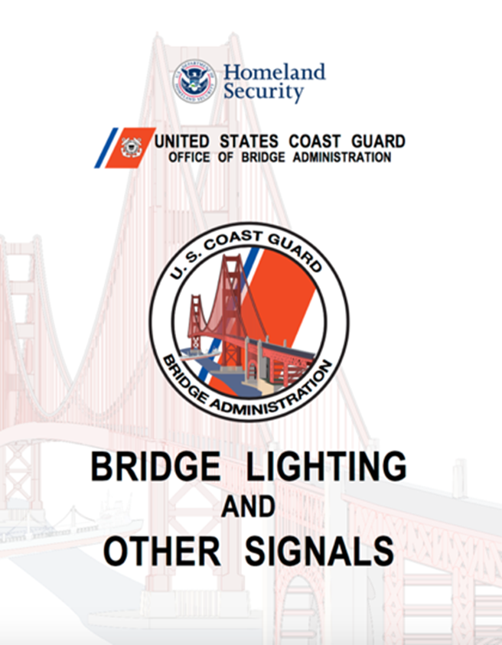

Bridge Administration

Slide 2
Bridge Classes
Class One – bridge handles large ocean going ship traffic. i.e. Tankers, container ships, LNG tankers, bulk carriers
Class Two - bridge handles smaller commercial and larger recreational boat traffic. Used by tugs & barges, but no ocean going vessels.

Slide 3
Bridge Classes
Class Three – bridge handles recreational traffic only. No tugs or barges use this bridge regularly.
  Class Four - nothing but rowboats and small outboards move under this bridge.
    The C.G. is not interested in these. Do not survey unless specifically requested.
    Can represent up to 60 percent of total bridges in your AOR.

Slide 4
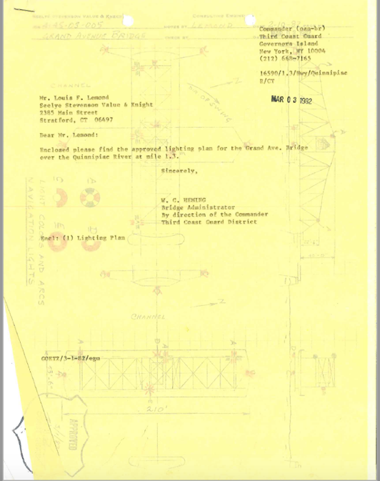
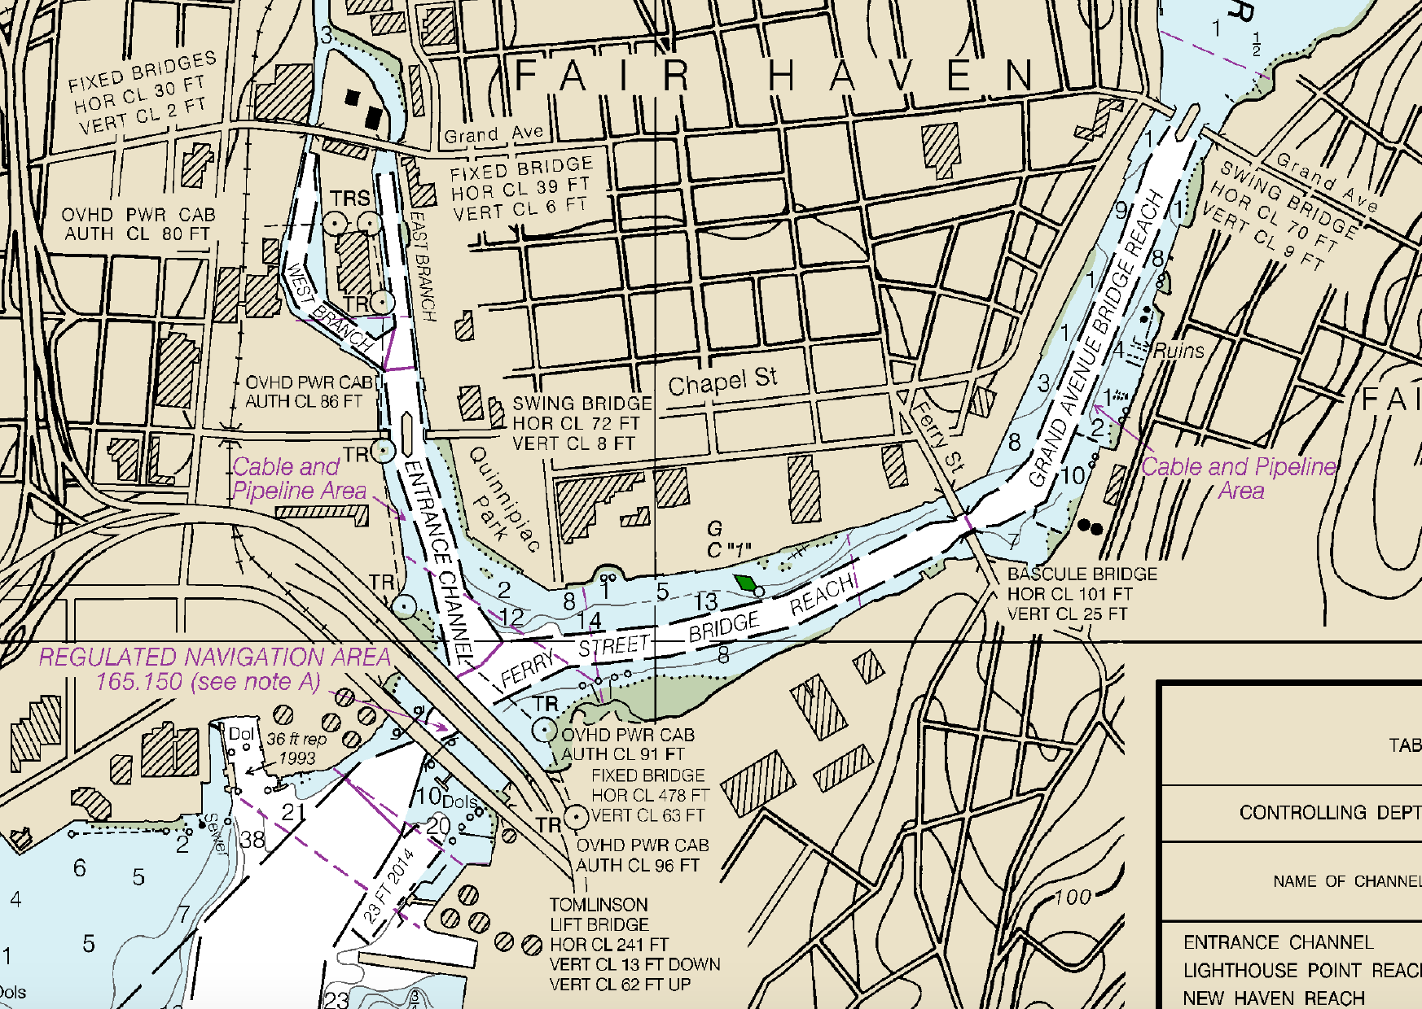
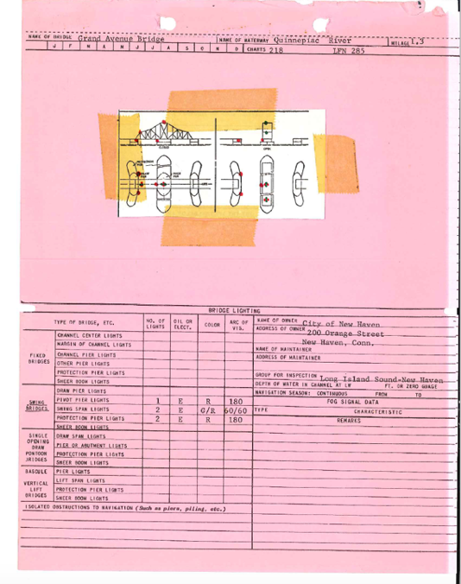
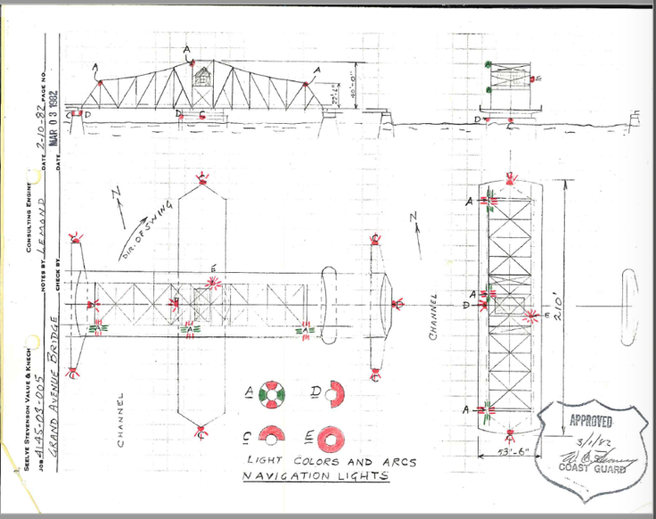
Bridge Light Permit:

Slide 5
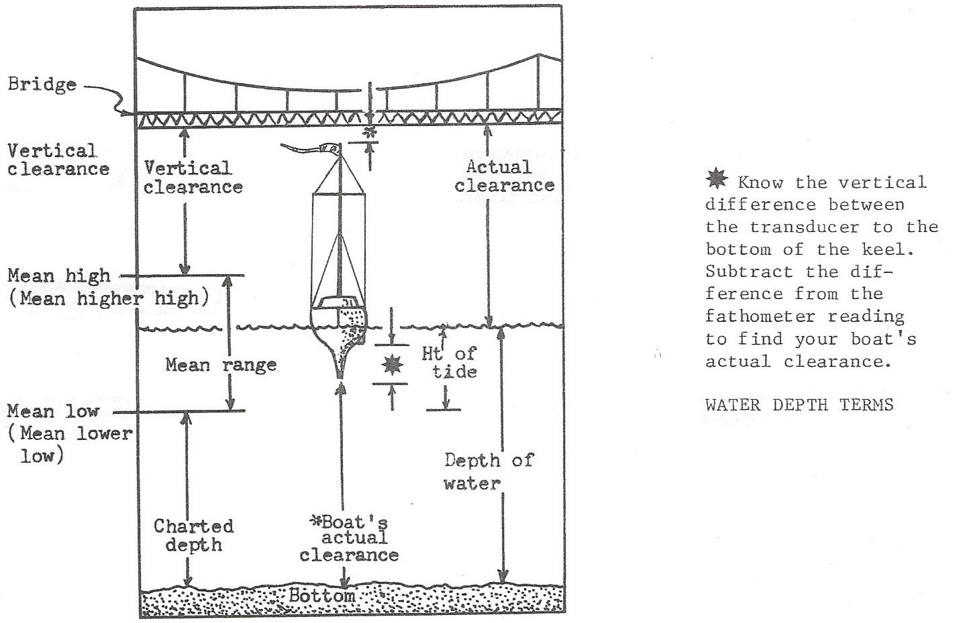

Slide 6
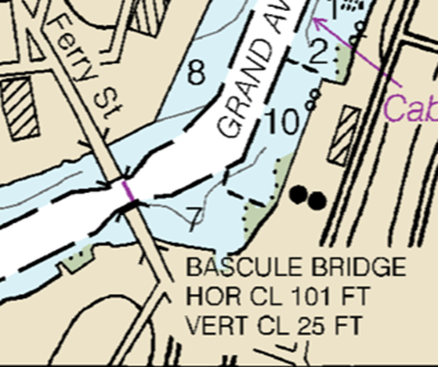
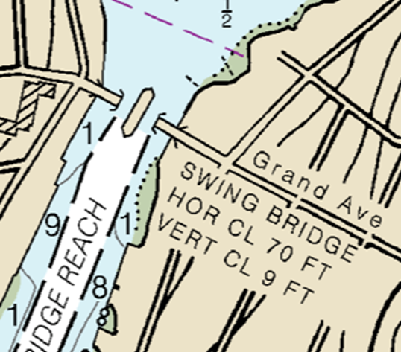
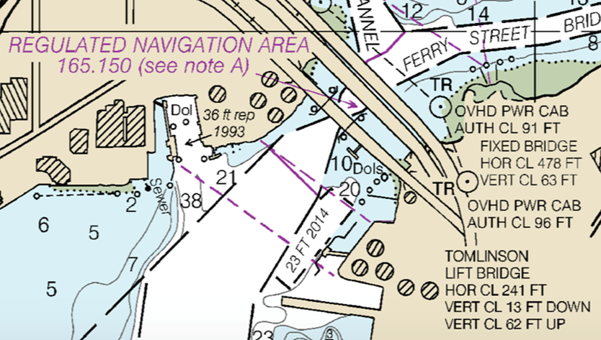

Slide 7
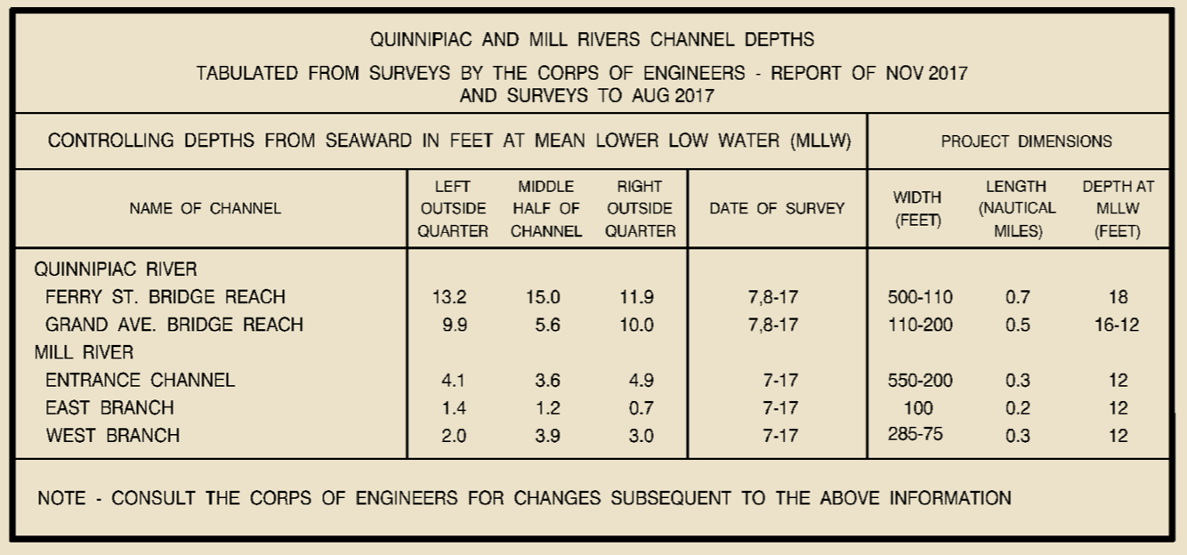

Slide 8
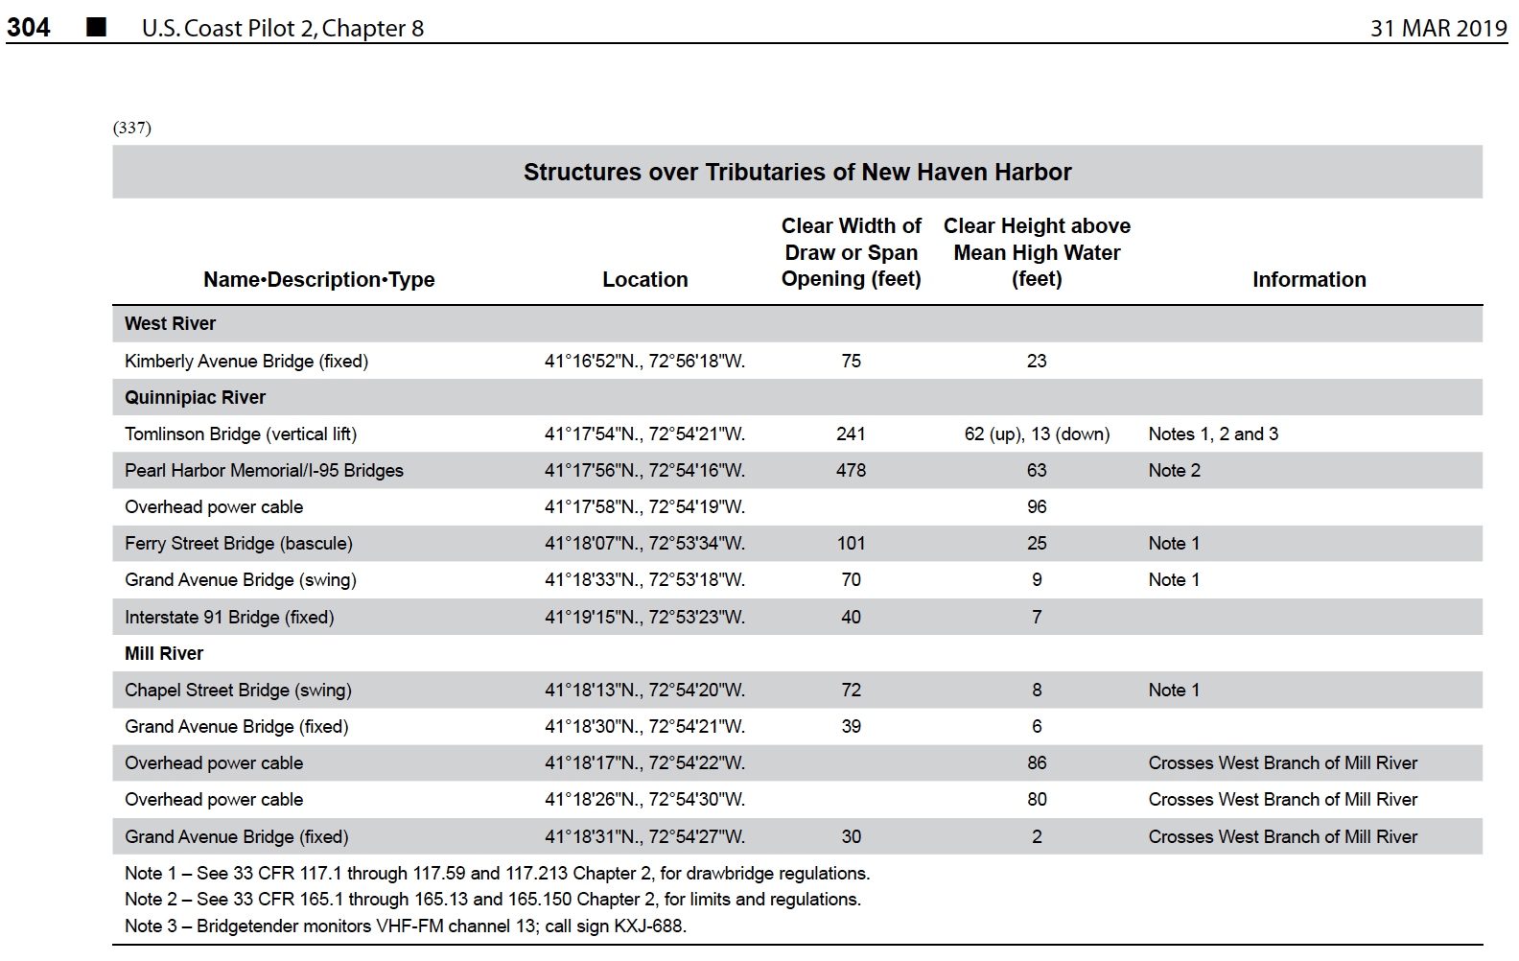
Coast Pilot

Slide 9
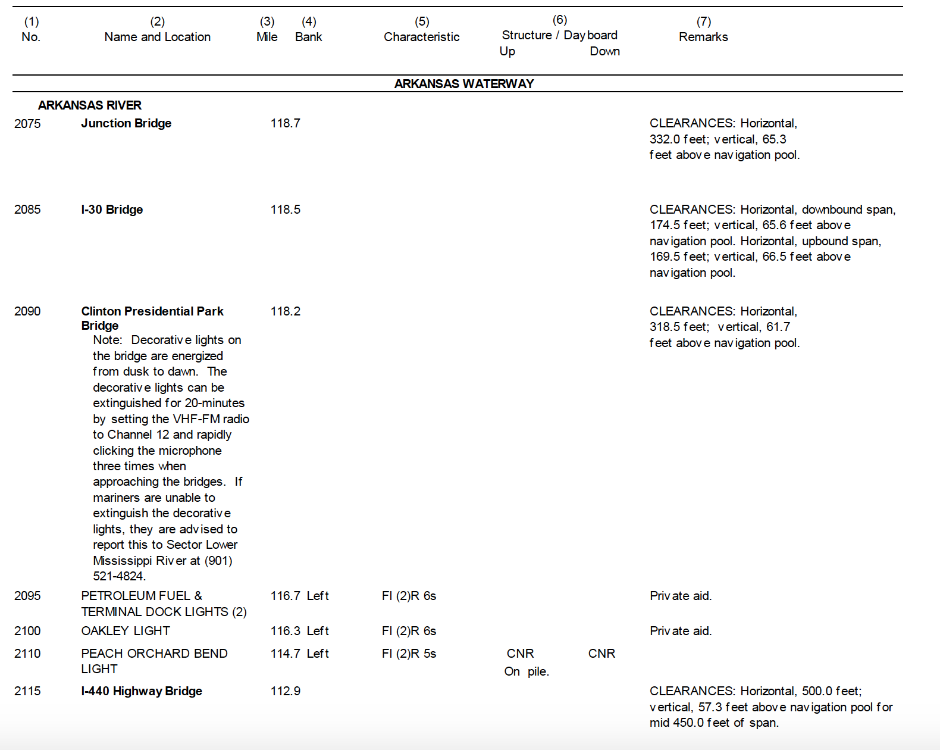
Light List

Slide 10
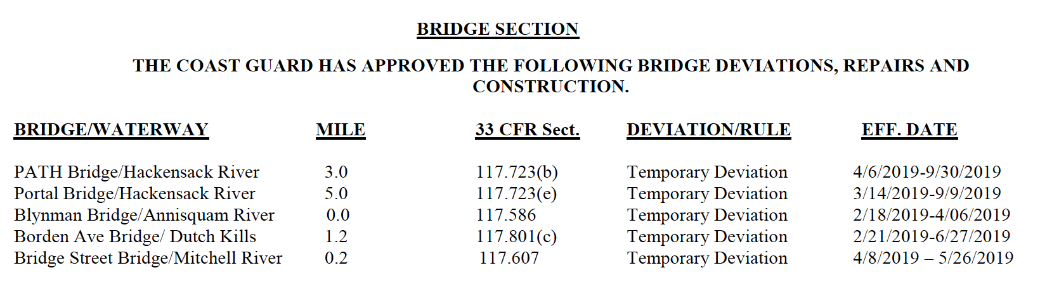
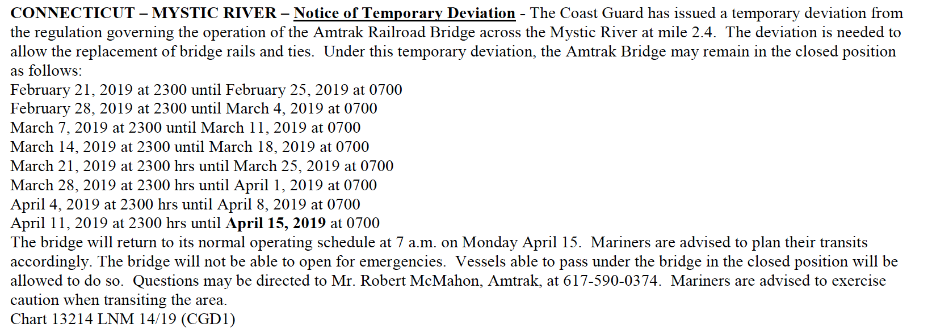
Local Notice to Mariners

Slide 11
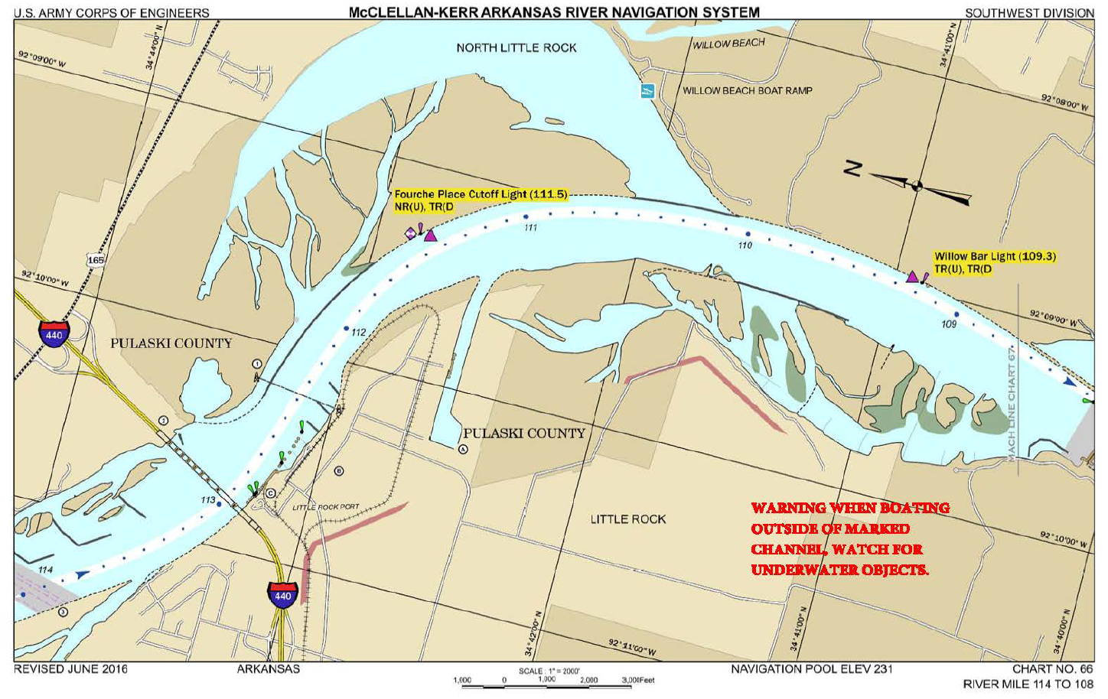
ACOE chart

Slide 12
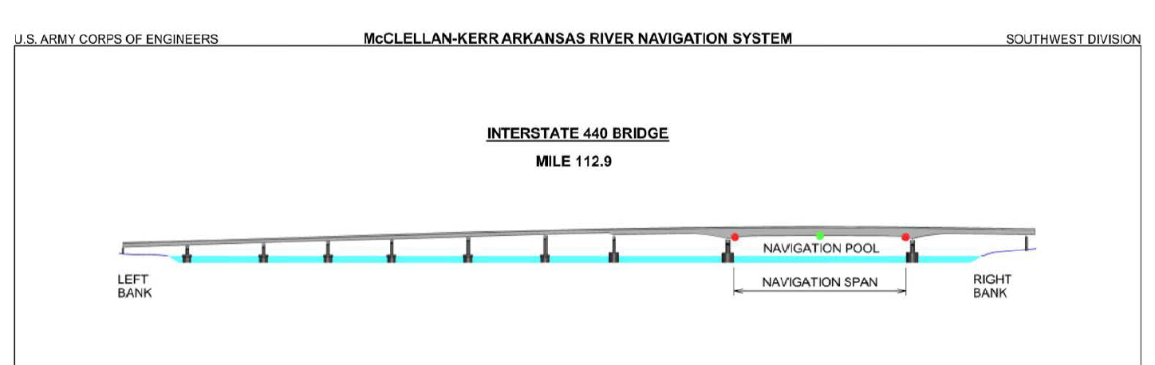
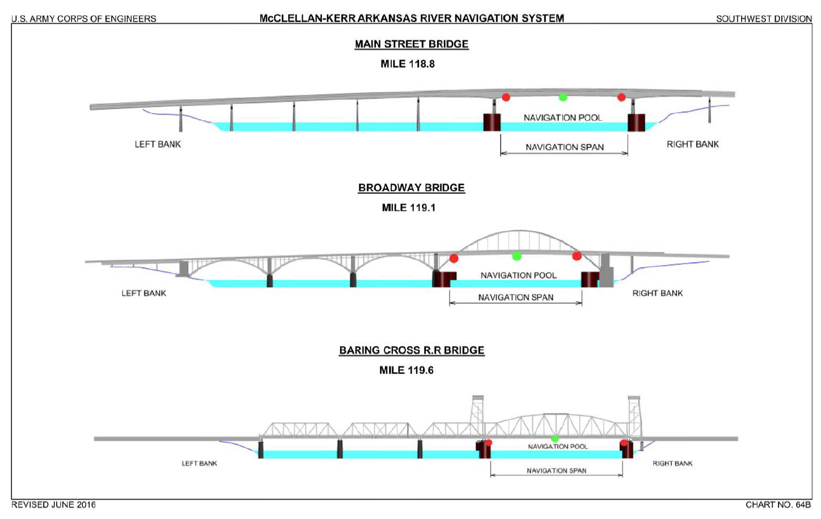
ACOE chart

Slide 13
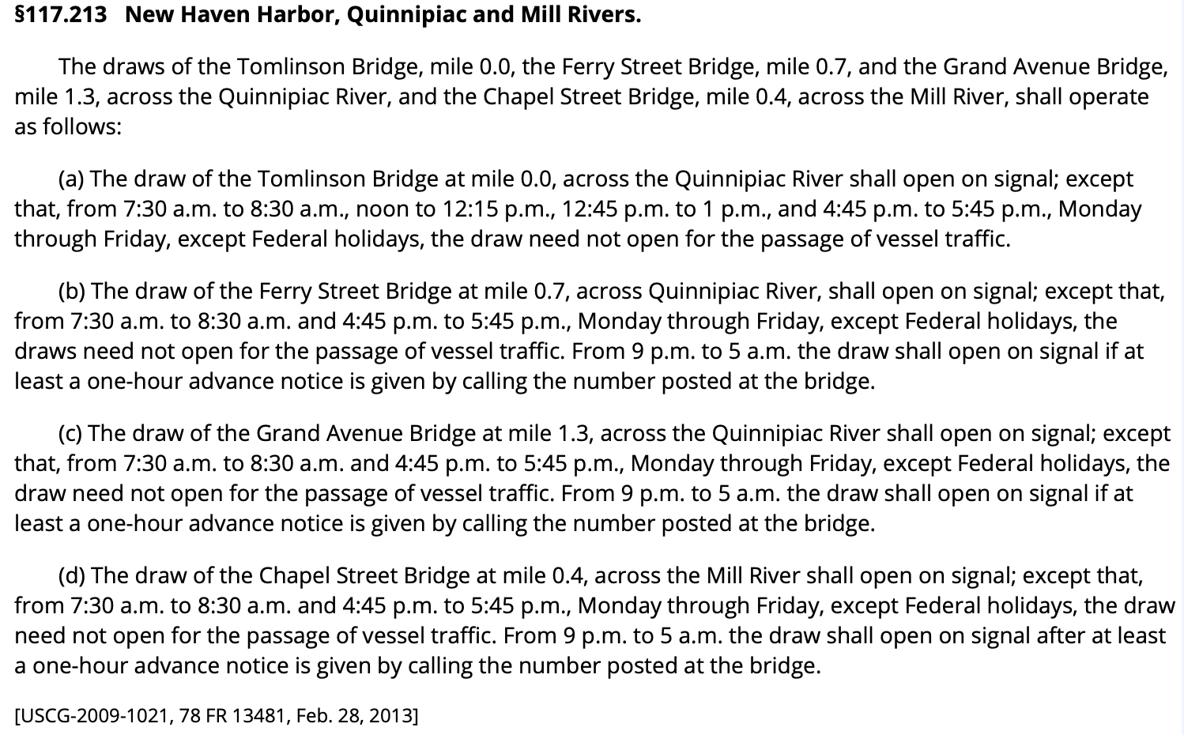
33CFR117 regulations

Slide 14
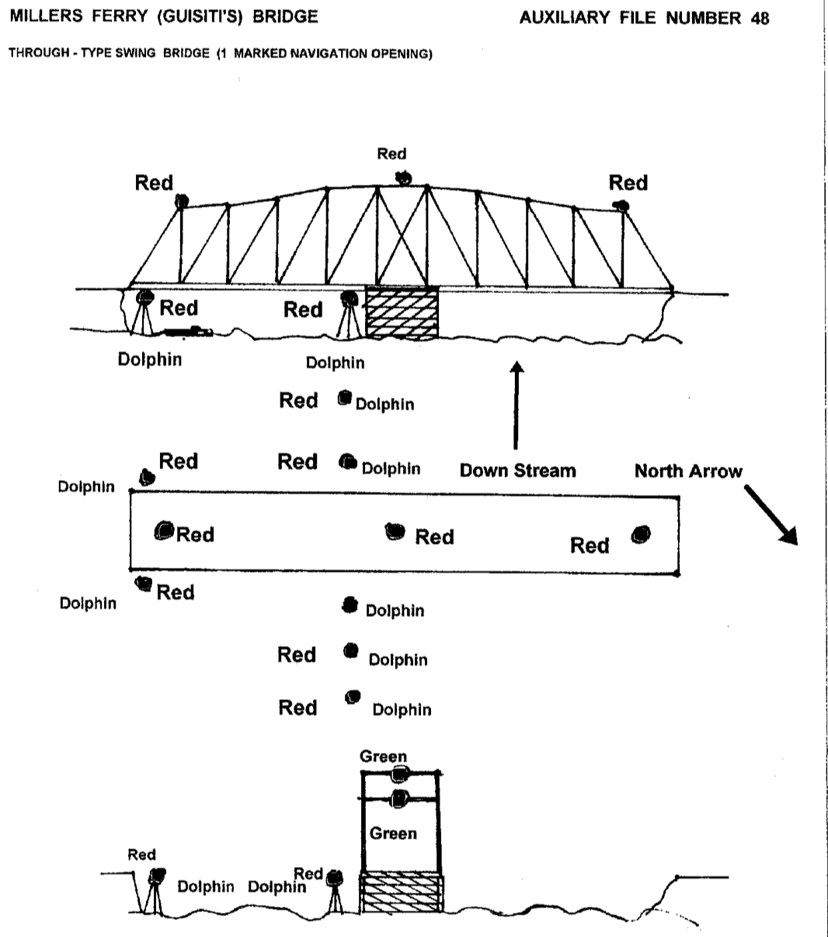

Slide 15
Bridge Lights:
Channel Center Lights G -360° 
Channel Margin Lights R- 180°
Pier Lights R- 180°
Channel Axis Lights R- 180°
Preferred Channel Lights 3W - 180 °
Movable Span Lights
R > G - 180°

Slide 16
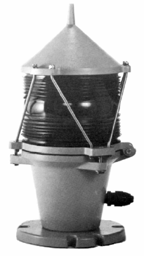

Bridge Lights:
LED Lanterns

Slide 17

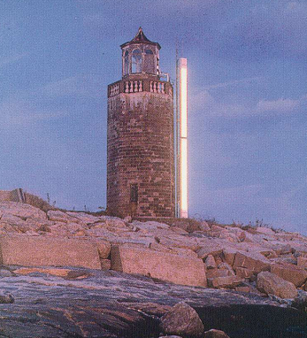
Bridge Lights:
Light Pipes
6” diameter tube illuminated from one end
Used in urban areas with high background lighting problems
Used for Channel Center Lights and Channel Margin Lights
Newer units going to LED lighting over full length

Slide 18
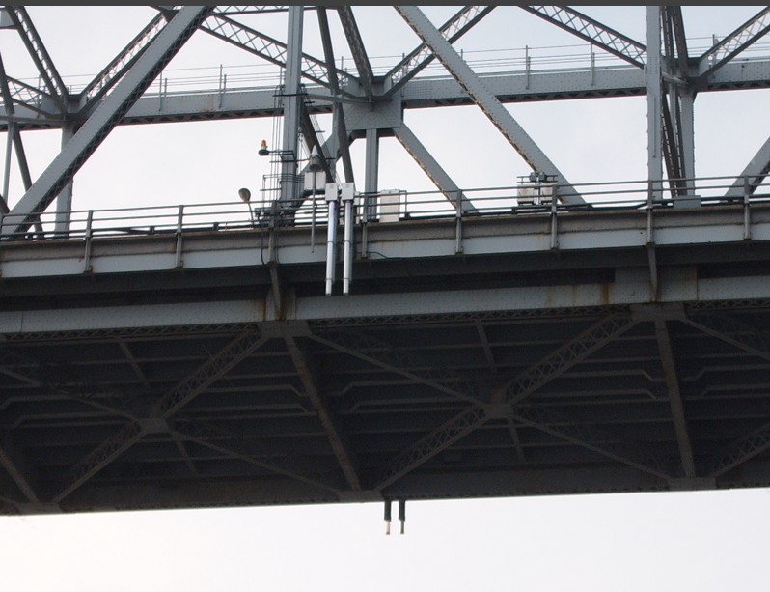
Light Pipes:

Slide 19
Channel Center Lights
(on Fixed Bridges)
  Two 360-degree lanterns, hang just under lip.
  Visible from both approach channels – up and down stream.
  Green in color.
  Lanterns should appear as range lights mounted under the lip of the bridge’s span.
  Mark the center of the navigable channel.

Slide 20
Movable Span Lights
(on Movable Span Bridges – Draw Bridges)
180-degree split-lanterns facing toward the
traffic.
  Shows a RED light when the draw is closed
  or moving.
  Shows a GREEN light when the draw is open.

Slide 21
Channel Axis Lights:
  180-degree lanterns that face the center of channel.
  RED in color.
  Mark any bends in the channel or turns in the pier structures on a bridge.

Slide 22
Channel Margin Lights:
  180-degree lanterns that face into the traffic.
  RED in color.
  Mark the edges of the navigable channel.
  Are positioned above the lip of the span. These lights mark low steel - the lower limit of the span clearance.

Slide 23
Channel Margin Lights
Lights define the limits of the navigable channel.

Slide 24
Pier Lights:
180-degree lanterns – facing the traffic. RED in color. Mark the piers on the bridge. Note that they are used for a different purpose than Axis lights.

Slide 25
Two Major Types of Bridges:
1. Fixed Bridges (1)
2. Movable Span or Draw Bridges (5)
  Lift Bridges
  Swing Bridges
  Bascule Bridges
      Single Bascule & Double Bascule
  Retractable Bridges

Slide 26
Single Span Fixed Bridge
Should be mounted just below the lip of the span.
Appears as a range under the lip of the span.
180° RED Channel Margin Lights
Channel Center Lights
360° GREEN

Slide 27
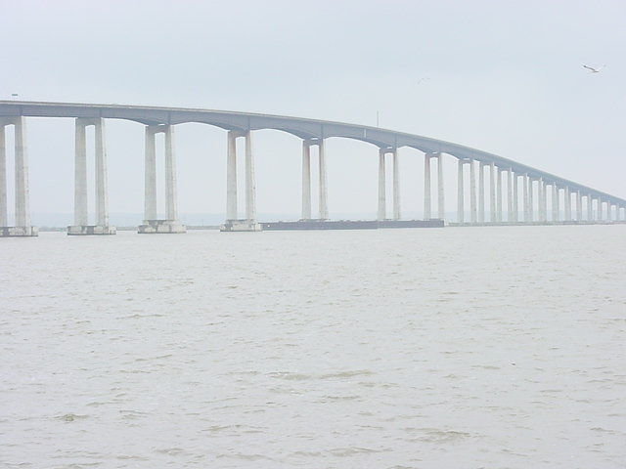
Multiple Channel Fixed Bridge

Slide 28
Multiple Span Fixed Bridge
3 180° White
Preferred Channel Lights
360° Green Channel Center Lights
180° Red Pier & Margin Lights

Slide 29
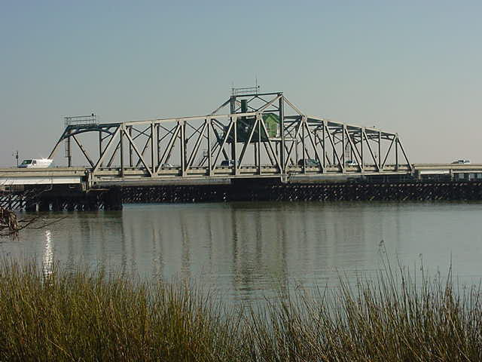
Single Span Swing Bridge - Closed

Slide 30
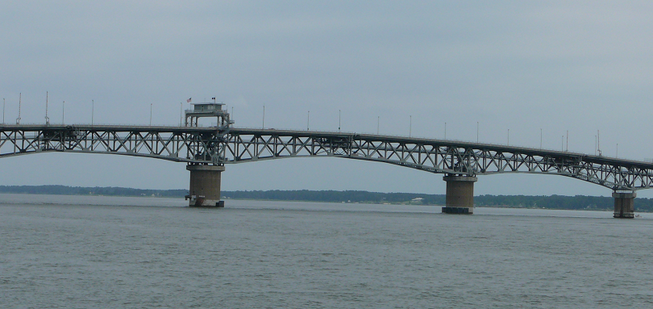
Double Span Swing Bridge - Closed
South Swing Span
North Swing Span
Pivot
Coleman Memorial Bridge, Yorktown VA

Slide 31
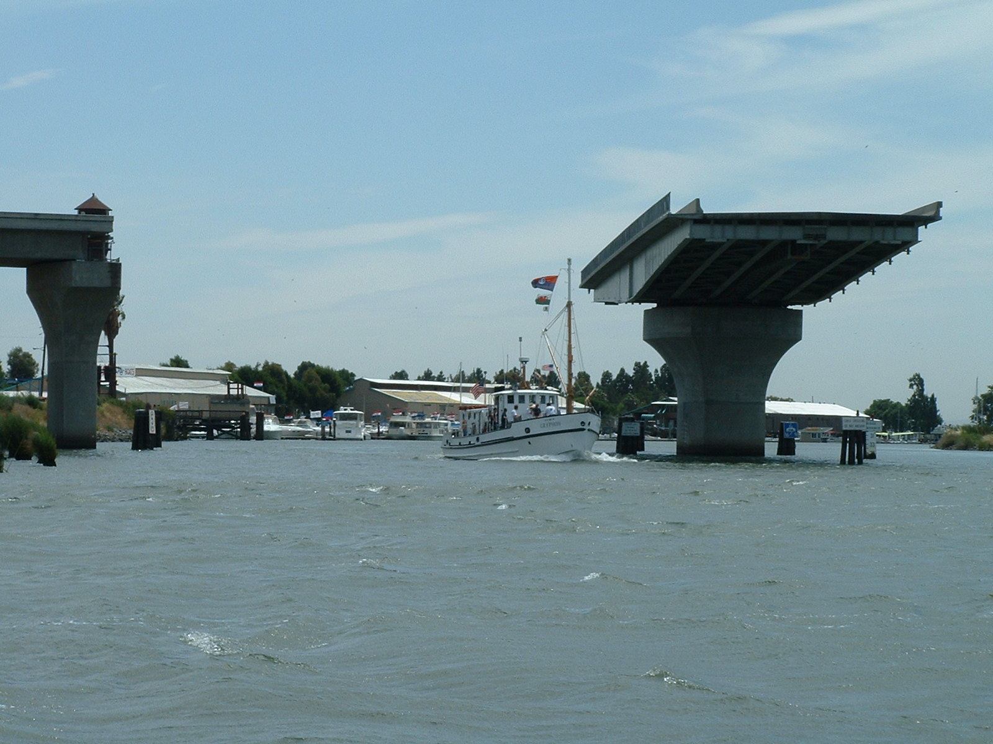
Swing Bridge - OPEN

Slide 32
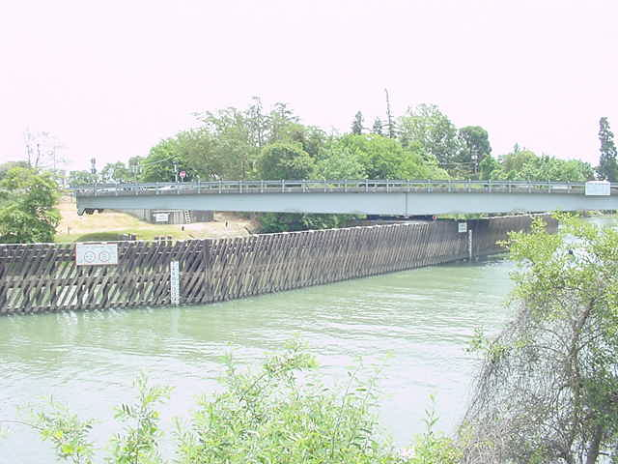
Swing Bridge – In Motion one navigable channel

Slide 33
Swing Bridge - Closed
Moveable Span Lights -alternate Red & Green, each 60° at 90° to each other. Show RED when the bridge is closed.
180° Red Pier Lights

Slide 34
Swing Bridge - Open
Moveable Span Lights-Alternate Red & Green, each 60° at 90° to each other.
180° Red Pier Lights

Slide 35
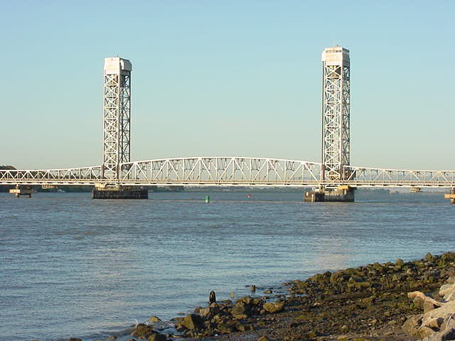
Vertical Lift Bridge Closed

Slide 36
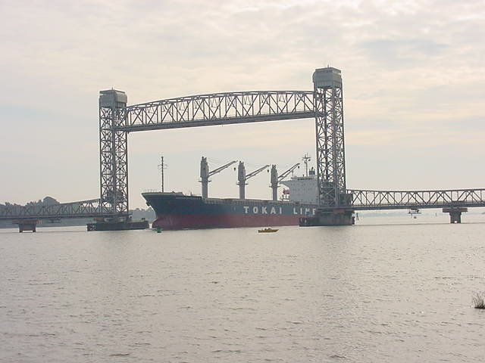
Vertical Lift Bridge – Open Chart may show Hor CL and the open and closed Vert CL.

Slide 37
Vertical Lift Bridge – Span is closed
180° Red Moveable Span Light is on.
360° Green Moveable Span Light is Out
180° Red Pier Lights

Slide 38
Vertical Lift Bridge – Span is open
180° Red Moveable Span Light is out
360° Green Moveable Span Light is on.
180° Red Pier Lights

Slide 39
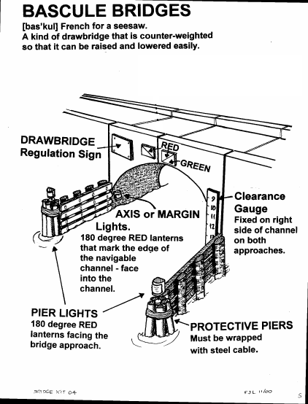

Slide 40
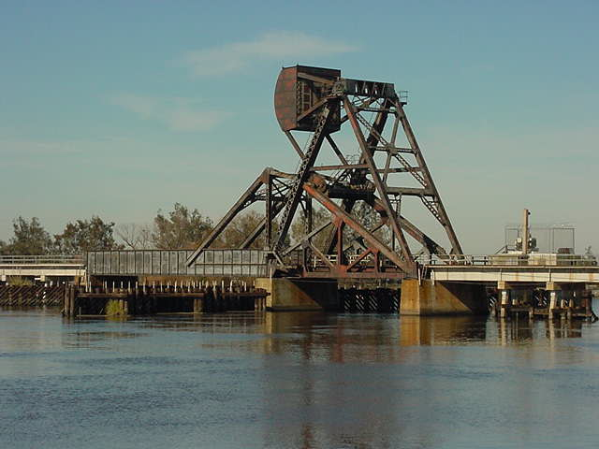
Single Bascule Bridge Closed

Slide 41
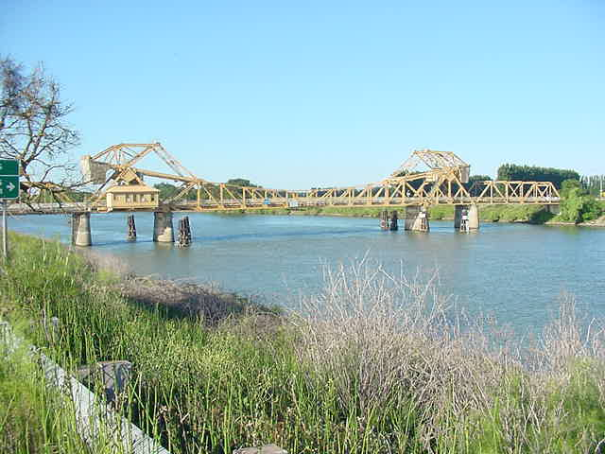
Double Span Bascule Bridge (closed)

Slide 42
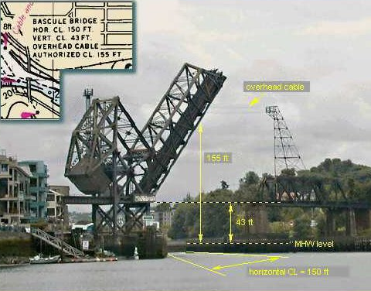
Bascule Bridge
Movable Span Light
Pier Lights

Slide 43
Single Bascule Bridge – Span is closed
180° Green Moveable Span Light is out.
180° Red Moveable Span Light is on.
180° Red Pier Lights

Slide 44
Single Bascule Bridge – Span is open
180° Green Moveable Span Light is on.
180° Red Moveable Span Light is out.
Draw must open to point where it clears the fenders

Slide 45
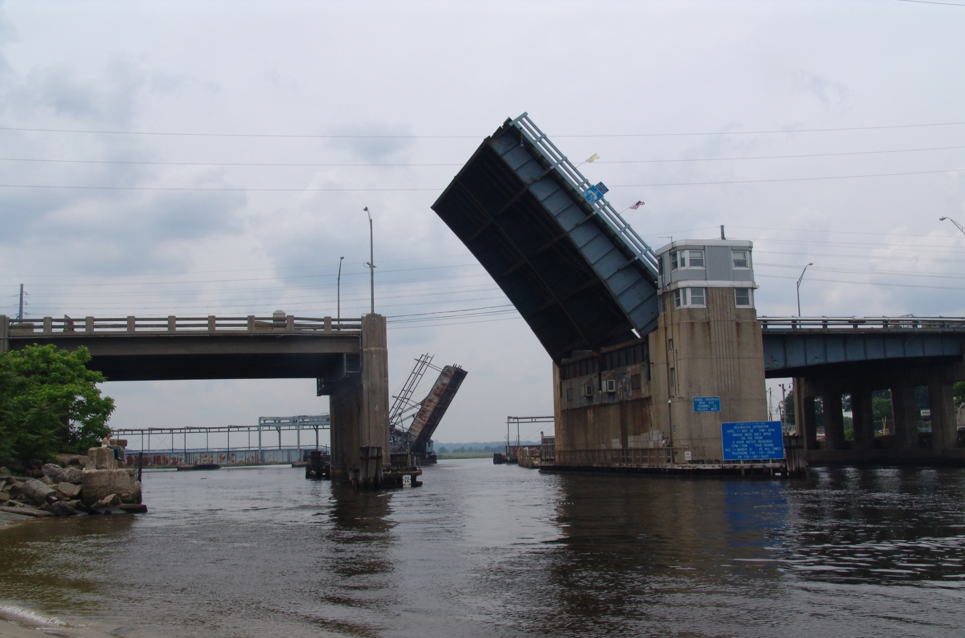
Single Bascule Bridge – Span open

Slide 46
Double Bascule Bridge
(Spans are closed)
180° Red Pier Lights
180° Green Moveable Span Light is out.
180° Red Moveable Span Light is on.

Slide 47
Double Bascule Bridge
(Spans are open)
180° Green Moveable Span Light is on.
180° Red Moveable Span Light is out.
180° Red Pier Lights

Slide 48
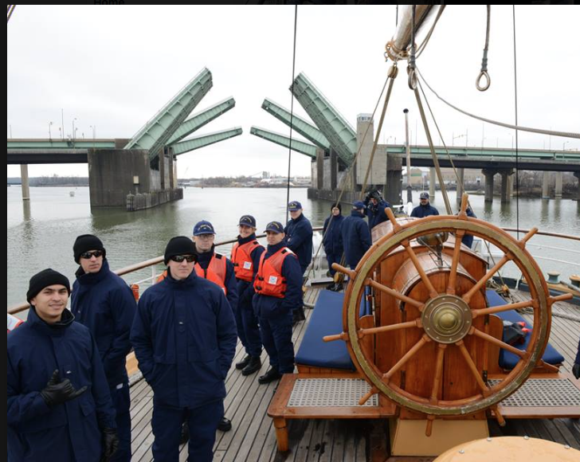
Adjacent Double Bascule Bridge
(Spans are closing)

Slide 49
Lighting Discrepancies
Broken Axis Light Lens
Unlit
Flow Down River

Slide 50
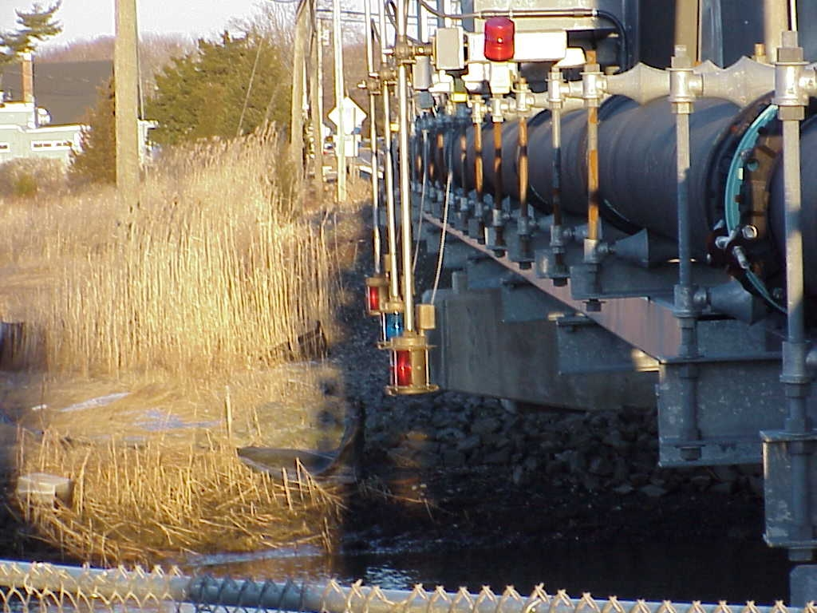
Navigational Lighting
ONLY GREEN LIGHT
SHOULD BE BELOW
LOW STEELOF BRIDGE

Slide 51
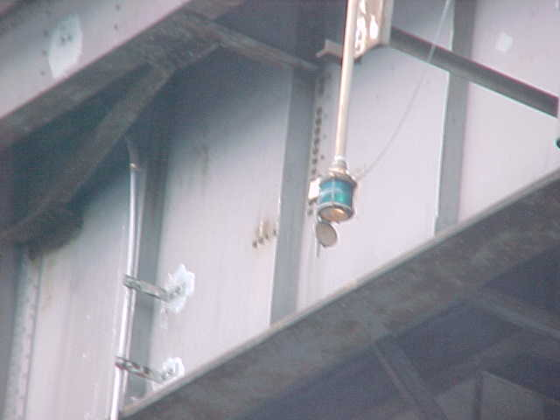
Lighting Discrepancy

Slide 52
Lighting Discrepancies
Lights extinguished / Dirty globe
Color and arc of visibility
Center of channel vs center of bridge location
Green center channel lights providing range (fixed bridges)
Red margin of channel lights no lower than low steel

Slide 53
Wales – the horizontal wooden components of the fender system
Wales must be:
  In good repair.
  Have no sharp metal or bolts sticking into the channel.
  Have no metal corners.

Slide 54
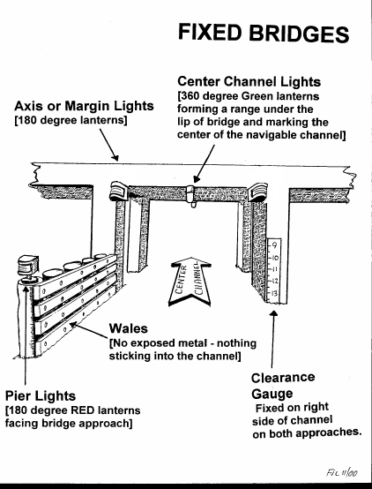
WALES

Slide 55
Special Regulation Signs must be:
Readable.
Located on both sides of bridge.
Match the Federal Regulations for that bridge in the 33CFR117 Subpart B
If a phone is required to open a lift bridge, the phone number must be shown on the regulatory sign.

Slide 56
Special Regulatory Signs

Slide 57
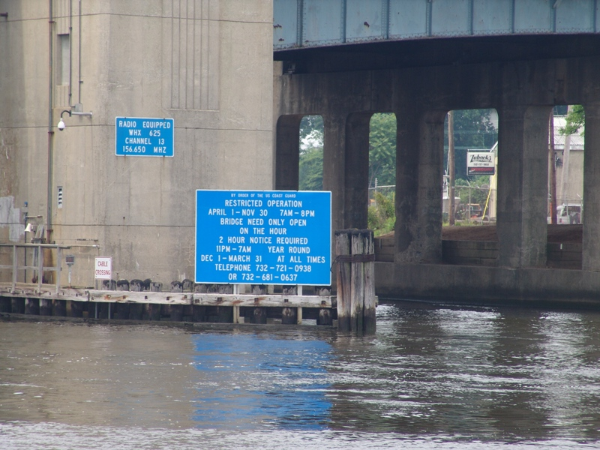
Bridge Signage

Slide 58
Fender Discrepancies:
Missing or broken wales
Fender protruding into channel
Steel/metal exposed to channel
Bolts not recessed
Dolphin clusters “leaning”
Broken or dirty vertical clearance gauge
Missing or inaccurate drawbridge operating regulatory sign
PHOTOS REQUESTED

Slide 59
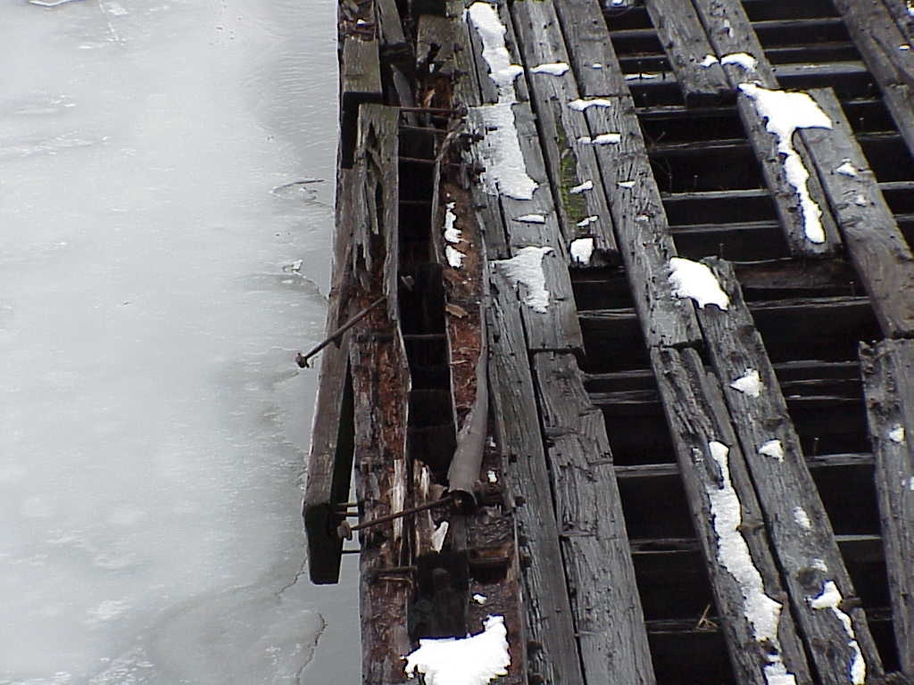
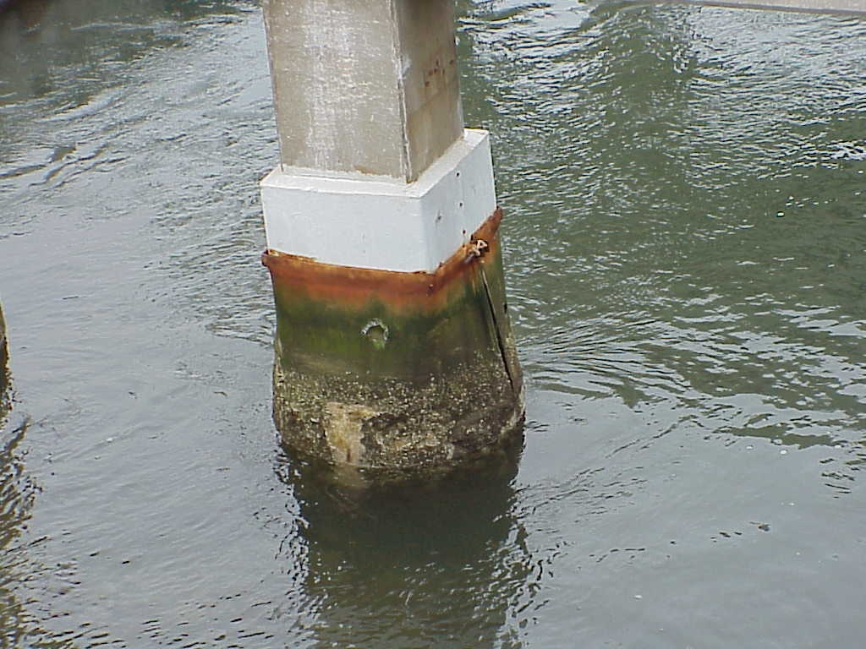
Bridge Fenders
STEEL JACKETING
PROTRUDING BOLTS
TOP VIEW

Slide 60
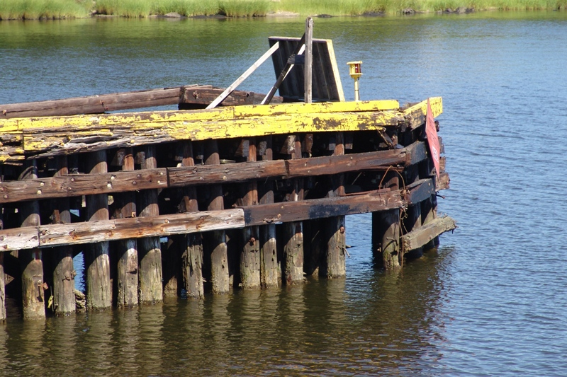
Missing Wales

Slide 61
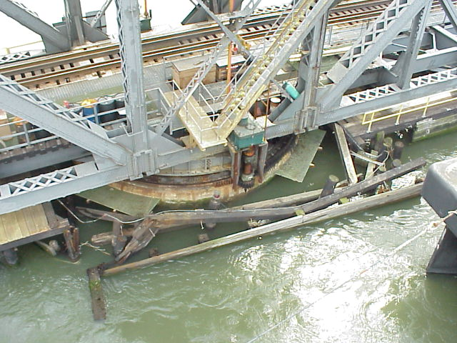
Fender Damage
Spuyten-Duyvil RR

Slide 62
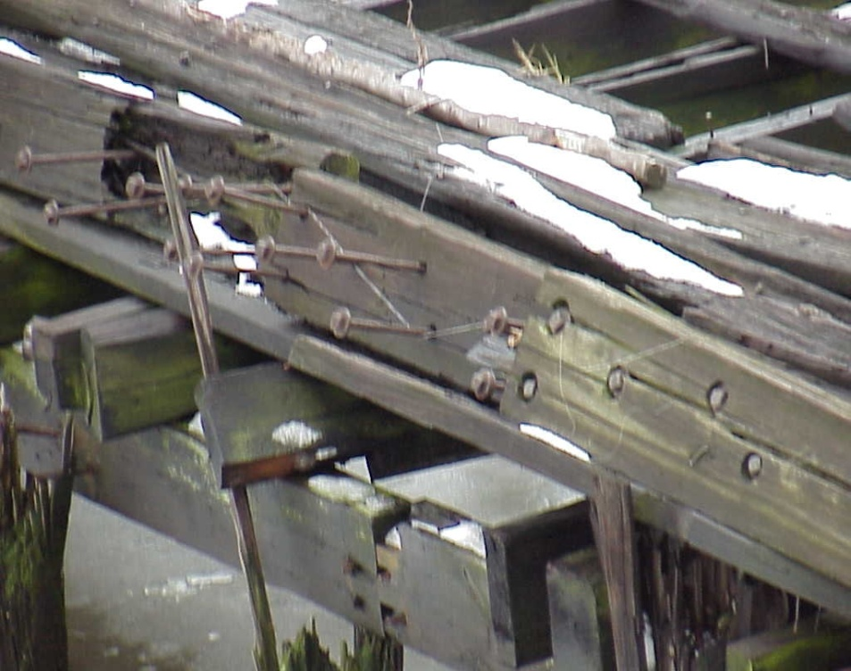
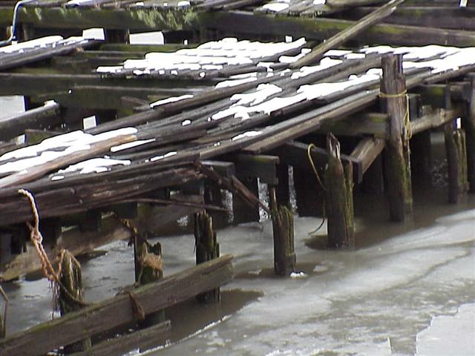
Bridge Fenders
MISSING WALES
PROTRUDING BOLTS

Slide 63
Protective Piers must be:
Wrapped with steel cable.
Have nothing projecting into the navigable channel.
Undamaged
Not be rotting at the waterline.
Not be rotting down from the top.

Slide 64
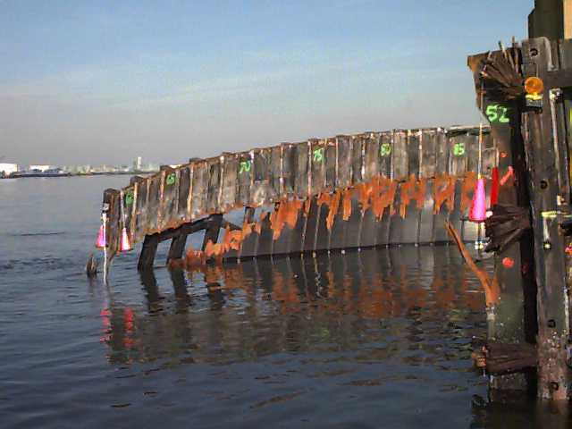
Damaged Cell

Slide 65
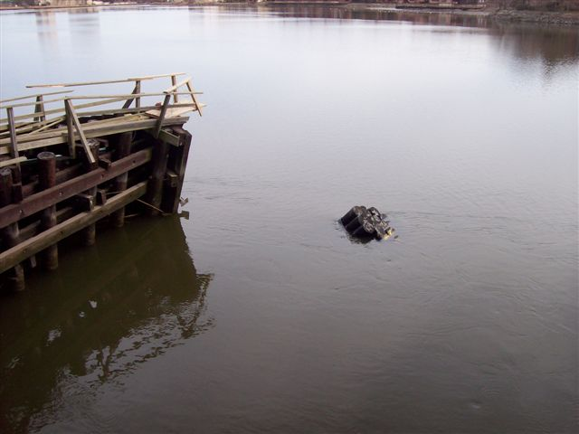
Leaning Submerged Cluster

Slide 66
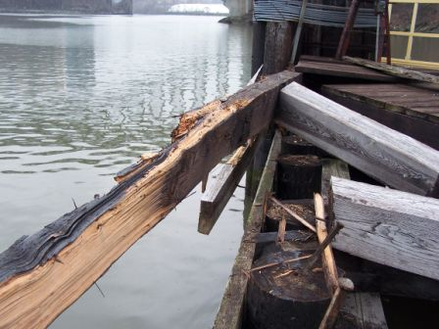
Protruding Wales

Slide 67
Clearance Gauges
May be required on both Fixed Bridges and Draw Bridges:
Required only if specified on CG Bridge permit
May be listed in 33CFR117 -Subpart B (may still be required by permit, even if not listed in 33CFR117)
Listing is also found in the Coast Pilot

Slide 68
CLEARANCE GAUGES
Clearance gauges are not always required but may be found on many Bridges. Check 33CFR117 or the Coast Pilot

Slide 69
Clearance Gauges
Should be mounted on the right side of the channel on both sides of the bridge (upstream & downstream).
Should be readable from ½ mile.
Must reflect the actual clearance from the lowest point of the span over the navigable channel to the actual water surface.

Slide 70
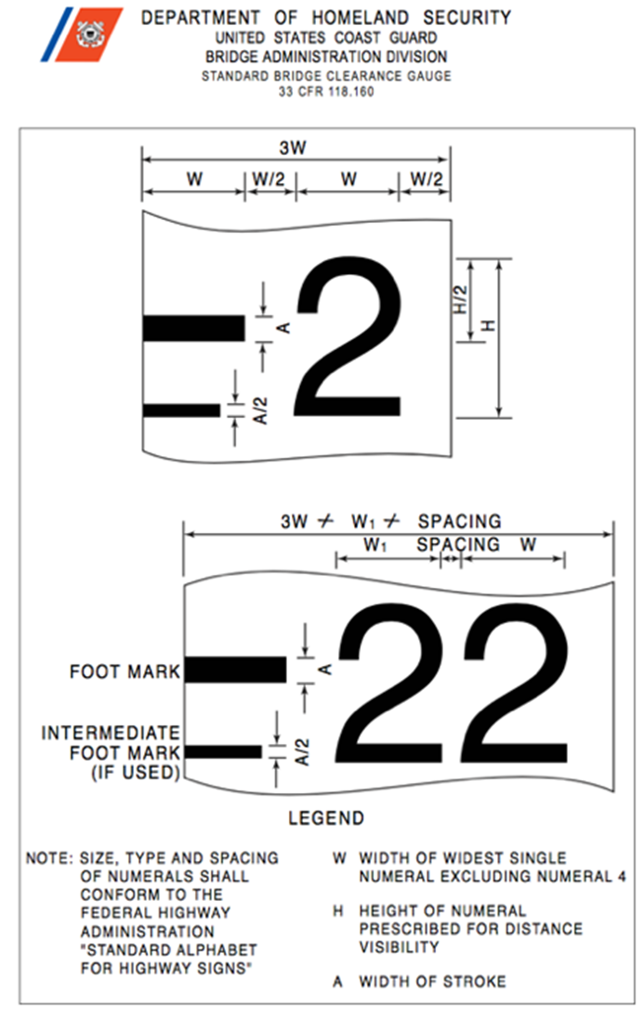
Clearance Gauges

Slide 71
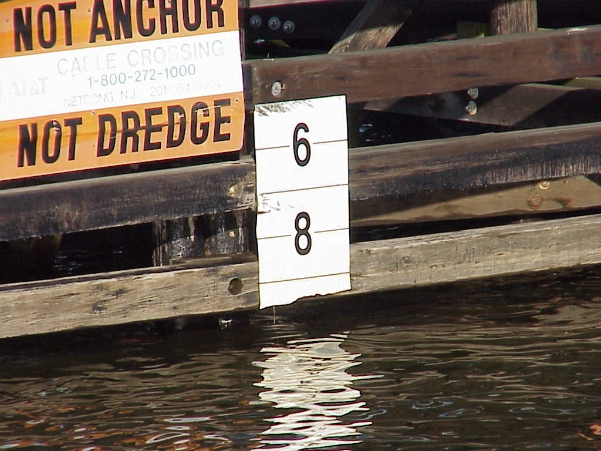
Broken Gauge

Slide 72

Racons
RACON: A radar beacon which produces a coded response or radar paint, when triggered by a radar signal.
Radar transponder beacons
Mounted at center of main channel on some major fixed bridges. Provides enhanced Morse coded echo on radar display.
Will be listed on chart if installed.
Use boat’s radar to verify proper operation of RACON

Slide 73




Slide 74


Fog Horns
Mounted at center of main channel on some major fixed bridges.
Will be listed on chart if installed.
Normally only sound when fog is present – can only be verified in fog!

Slide 75

Harlem River – Broadway Bridge

Slide 76

Harlem River- Spuyten-Duyvil

Slide 77

Spuyten-Duyvil - tight fit

Slide 78

Bridge Construction
NAVIGATIONAL CHANNEL THROUGH BRIDGE CONSTRUCTION SITE

Slide 79

Victory Bridge Demolition

Slide 80

Victory Center Pier Demo

Slide 81

Going - Going - Gone!!!

Slide 82
Obstructions in the Channel
Nothing may be hanging down from the span of the bridge into the navigable channel.
Report any shoaling or other obstructions in the channel.
Is the channel navigable?
Is any debris caught in the fenders sticking into the channel?

Slide 83
33CFR117 Subpart A - General Requirements
Subpart A documents the C.G. regulations for operating a drawbridge.
This presentation only shows selected highlights from 33CFR117. The full text is available on line.

Slide 84
33CFR117 – Drawbridge Regulations
Sec. 117.5 When the draw shall open.
Except as otherwise required by this subpart, drawbridges shall open promptly and fully for the passage of vessels when a request to open is given in accordance with this subpart.

Slide 85
33 CFR 117.9
Delaying the opening of a draw.
No person shall unreasonably delay the opening of a draw after the signals required by Sec. 117.15 have been given.
Note: Trains are usually controlled by the block method. That is, the track is divided into blocks or segments of a mile or more in length. When a train is in a block with a drawbridge, the draw may not be able to open until the train has passed out of the block and the yardmaster or other manager has “unlocked” the drawbridge controls.
The maximum time permitted for delay is defined in Subpart B for each affected bridge. Land and water traffic should pass over or through the draw as soon as possible in order to prevent unnecessary delays in the opening and closure of the draw.
10 minutes is usually considered the maximum time a vessel can be delayed.

Slide 86
Closing of the draw
Once a vessel has called for an opening, an open bridge may not be closed until that vessel has cleared the bridge.

Slide 87
33CFR 117.15 Signals
(a) General.
(1) The operator of each vessel requesting a drawbridge to open shall signal the drawtender and the drawtender shall acknowledge that signal. The signal shall be repeated until acknowledged in some manner by the drawtender before proceeding.
(2) The signals used to request the opening of the draw and to acknowledge that request shall be sound signals, visual signals, or radiotelephone communications described in this subpart.
(3) Any of the means of signaling described in this subpart sufficient to alert the party being signaled may be used.

Slide 88
33CFR 117.15 Signals
(b) Sound signals.
(1) Sound signals shall be made by whistle, horn, megaphone, hailer, or other device capable of producing the described signals loud enough to be heard by the drawtender.
(2) As used in this section, “prolonged blast'' means a blast of four to six seconds duration and “short blast'' means a blast of approximately one second duration.
(3) The sound signal to request the opening of a draw is one prolonged blast followed by one short blast sounded not more than three seconds after the prolonged blast. For vessels required to be passed through a draw during a scheduled closure period, the sound signal to request the opening of the draw during that period is five short blasts sounded in rapid succession.

Slide 89
33CFR 117.15 Signals
(4) When the draw can be opened immediately, the sound signal to acknowledge a request to open the draw is one prolonged blast followed by one short blast sounded not more than 30 seconds after the requesting signal.
(5) When the draw cannot be opened immediately, or is open and shall be closed promptly, the sound signal to acknowledge a request to open the draw is five short blasts sounded in rapid succession not more than 30 seconds after the vessel's opening signal. The signal shall be repeated until acknowledged in some manner by the requesting vessel.

Slide 90
33CFR 117.15 Signals
(d) Radio telephone communications.
(1) Radiotelephones may be used to communicate the same information provided by sound and visual signals. Note: Call signs and radio channels for drawbridges with radiotelephones are listed in Appendix A to this part.
(2) The vessel and the drawtender shall monitor the frequency used until the vessel has cleared the draw.
(3) When radiotelephone contact cannot be initiated or maintained, sound or visual signals under this section shall be used.

Slide 91
Bridge Operation
Is the draw operational?
Did the bridge tender respond immediately?
If a phone was required, was the phone number correct, and was it answered?
Was the person answering the phone knowledgeable?
Did the horns and alarms on the bridge operate effectively?

Slide 92
The focus of bridge survey and discrepancy reporting:
Prevention
Accuracy
Credibility
Professionalism
Service to the Coast Guard.

Slide 93
The Bridge Program has two components:
Bridge Discrepancy Reports
  Problem reports from any member
Bridge Surveys
  A comprehensive review and report of a bridge done by qualifed Aids Verifiers

Slide 94
Bridge Survey Report
A detailed review of bridge lights, signs, fenders, gauges & prior discrepancy reports to see if bridge is in compliance with their C.G. bridge permit.
While discrepancies are reported by any member, surveys are done by certified Aids Verifiers.

Slide 95
Bridge Discrepancies
Allows the staff at the Coast Guard Bridge Branch to contact the bridge owner and get the discrepancy fixed.
Any CGAUX member can file bridge discrepancy reports. Coxswains should keep Bridge Discrepancy forms aboard their facilities.
Report discrepancies within 24 hours of the observation, using your district’s report routing procedure.

Slide 96
Bridge Discrepancies
Information Needed:
  Any problems on the bridge that affects navigation.
  Any deviation from the CG bridge permit.
Not Needed:
  Non-navigational issues (e.g., bridge condition (except where it affects boats), problems on the bridge roadway.
  Water depths (USACE issue, not bridge office)
  Vertical clearance (unless obstruction is observed).

Slide 97
Bridge Discrepancies
Survey and discrepancy reporting processes and forms vary by District.
However, information required for reporting is the same as shown on the NS 7055 form (Prevention website).

Slide 98


Slide 99


Slide 100


Slide 101

Entering observations in the “Discrepancy” section:
Bridge Discrepancy Report
Use “Comments” section to accurately describe the problem and where on the bridge it is located.
Include digital photos of each discrepancy whenever possible.

Slide 102
Bridge Discrepancy Report
Send report, along with digital photos, within 24 hours of observing the discrepancy.
Include digital photos as evidence to support your observations whenever possible – a picture speaks a thousand words!

Slide 103
Bridge Discrepancy Report
When the CG Bridge Office is alerted of a discrepancy, they send an written order to the bridge owner to repair the deficiency.

Slide 104


Slide 105
USCG Bridge Letter
An order to the bridge owner to repair the deficiency.
Gives the owner a set time frame to make repairs.
Should be sent back to original observer –
  lets them know their work counted and tells them when to recheck the bridge again.

Slide 106
Bridge Surveys
Periodic detailed review of lights, signs, fender systems & gauges.
Checks bridge against its USCG permit requirements.
Provides follow up for checking prior reported discrepancies.
Performed by certified Aids Verifiers.

Slide 107
When you use the term Watching Properly, it is assumed that you did a complete check of the bridge. This usually requires two visits: one during the day at low tide to check e.g. fendering system and gauges, and one at night to check lights.

Slide 108
Always fill out a complete Light Survey, Fender System Survey, and check the regulatory sign the first time you survey a bridge. Recheck all lights and fenders at each subsequent survey. Recheck gauges & signs at each subsequent survey.

Slide 109
Reminder…
The Bridge Survey or the Bridge Discrepancy forms get the bridge problem data to the USCG Bridge Branch Office.
You also must report your activity to your IS officer on an ANSC 7030 report (Unit/Individual) to get Auxiliary credit for the work.

Slide 110
AuxData
AtoN activity (including bridge work) is reported on a 7030 (Unit/Individual)
Never put AtoN activity (missions 30, 31 or 32) on a 7030 (Boat)
Only one person gets 7030 credit for each discrepancy (not all those on the boat)
30 - AtoNs 31- PAtoNs 32 - Bridges

Slide 111
Bridge Discrepancy Reporting
This Auxiliary program can be quite satisfying, and provides great service to the U. S. Coast Guard and the maritime community.
Our emphasis is on prevention, accuracy, credibility, professionalism and service to the United States Coast Guard

Slide 112
The End

